Slide 1



CAMPUS to Cogitate 2023
Jan‘23
01
02
03
04
05
06
07
08
AIM
Requisition
Journey
Induction Plan
Fresher Learning Program
Domain Training
Connect Calendar
Evaluation
Digital Insurance Accelerated

Slide 2

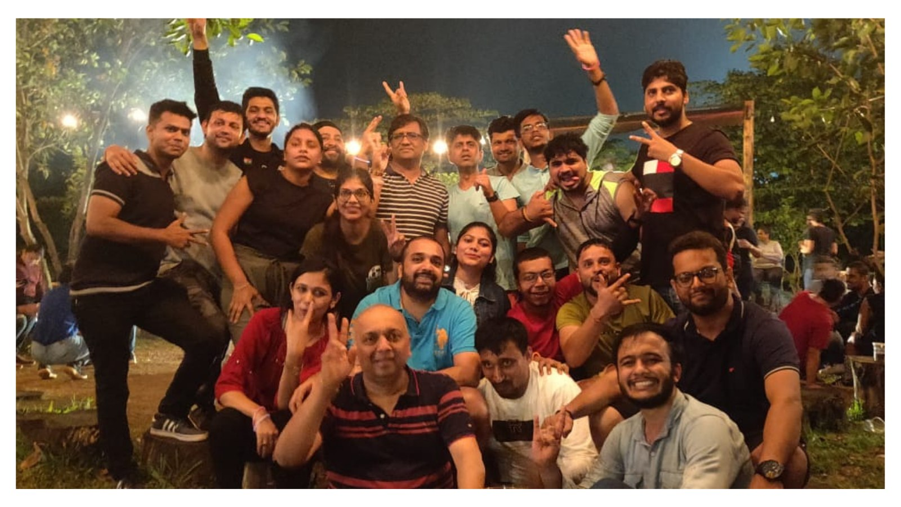




AIM
LEARN
HAVE FUN
CAMPUS
2
CAMPUS
2
SUCEED

Slide 3
CAMPUS HIRES
Sr No | Designation | Name | Project | Mentor | Project Manager | Type
1 | Ass Dev | Pratik Bagad | FTP | Sridhara | Vinay | Campus
2 | Ass Dev | Pranali Patil | BSG | Kushagra | Vinay | Campus
3 | Ass Dev | Madiha Mujawar | ENGS | Kushagra | Vinay | Campus
4 | Ass Dev | Rushikesh Naikwadi | RPS | Sridhara | Mayur | Campus
5 | Ass Dev | Vijay Sagar | IH 2.0 | Sachin B | Rahul | Campus
6 | Ass Dev | Rohit Narnaware | Product & Innovation | Kushagra | Kathir | Campus
7 | Ass Dev | Jaswant Sai | Product & Innovation | Sachin B | Kathir | Campus
8 | Ass Dev | Suraj Salunkhe |  | Shridhara | Kathir | Campus

Slide 4
Journey
Induction
Confirmation
On Clearing 90 (OR) 180 days Review
3rd July
Mini Project
90 days Review
Freshers Learning Program
90 days Review
4th July
30th July – 4th Aug
10th Nov
Project Assignment
7th Aug
60 days Review
6th Oct
Domain Training
14th July
30 days Review
8th Sep
*The Students will be on a study leave :

Slide 5






DAY 1 - BUSINESS INDUCTION & ORIENTATION
  3rd July
Ice Breaker
Business Orientation
HR Policies
IT and Infra Setup
Lunch
Zenildo
Short activity to warm up the group
Nikhil + Zenildo
(Business orientation and introduction to the originations vision, structure, growth and products)
Zenildo
(Details on HR Policies, Process and Norms and introduction to HR)
Mandar
(Installation of office peripherals and information on IT protocols)
Nikhil, Zen & Managers
(Team Lunch at Ramada)

Slide 6





DAY 1 - BUSINESS INDUCTION & ORIENTATION
  3rd July
Documentation & Banking
Team Activity
HRMS Session
Connect with Manager
Distribution of Goodies
Payal
(Collection of Documents and Opening a bank account with IDBI Bank)
Zenildo
(Interactive activity for the team)
Zenildo
(Details on HR Policies, Process and Norms and introduction to HR)
Manager
(Introduction to manager / Mentor, brief on expectations)
Payal
(Welcome goodies)

Slide 7




DAY 2 FUNCTIONAL INDUCTION
INTRODUCTION WITH MENTOR
  LEADERSHIP
  FAST LANE
EXPERIENCE @ COGITATE
FRESHERS LEARNING PROGRAM
Mentor
Mentor to introduce them selves and the work culture. Set Expectations
Zenildo
Business Communication Session
Kushagra, Vinay & Ashish
Introduction to Ashish
Motivational talk by Vinay and Kushagra
Kushagra & Zenildo
Introduction and explanation about The Freshers Learning Program

Slide 8
Developers Training
MODULE
01
02
03
04
05
06
07
TOPIC.
HTML , CSS, bootstrap, JavaScript , jQuery & git commands
Introduction Visual Studio IDE ……………………
MVC Fundamentals ………………………………………
SQL Server basics …..……………………………………
MVC Simple CRUD Application …………….........
MVC Advanced (MVC Filers, Grid) ……………….
Mini Project
( MVC Advanced CRUD application with Authorization & Authentication)
TEST DATE
7th July
10th July
18th July
20th July
23rd July
25th July
30th July
*Test scores will be maintained for future reference

Slide 9
Connect Calendar
Q1
Jul
Aug
Sep
HR
31th July
16th Aug
18th Sep
Ashwin
5th July
Arvind
12th Jul
Arvind
Ashish
7th Jul
16th Aug
Nikhil
3rd Jul
30th Aug Feb
Discussion on Campus Batch
29th Sep

Slide 10
EVALUATION
30 Days Review
Mentor, P M, Nikhil, HR
Observations on FLP
60 Days Review
PM, Ashish, Nikhil, HR
Observation on the project assignment .
Initiative and learnability
CONFIRMATION
PROCESS
90 Days Review
PM, Ashwin, Ashish, Nikhil, HR
Feedback on technical understanding and capabilities
CONFIRMATION
Based on 90 day Feedback (OR)
Further Evaluation till 180 days
180 Days Review
PM, Ashwin, Ashish, Nikhil, HR
Review on performance and technical skills
(Initiate exit if found unsatisfactory)

Slide 11


Freshers’ Learning & Onboarding Program
Digital Insurance Accelerated

Slide 12
Welcome!
Hey Guys,
First, welcome to the corporate world and congratulations on taking this leap in your life. It is okay to feel a bit overwhelmed at this stage, even we did when we started. It will get better as you spend more time with us.
To handhold you and to smoothen this transition, we have crafted a 360 degree training plan for you across tech, domain etc. We will also have a senior member mentor you for next 6 months, consider him/her your friend and ask anything you want.
Also, feel free to reach out to us, we’re here to help you.
- Team Cogitate

Slide 13
Handholding Connects
These connects will help you resolve queries and get timely feedback
Mentor Sessions | Handholding by mentor for 6 months (Query resolution session)
Mentor | Mentor assignment to be shared over email on 1st day.
Frequency | 30 min session every Day for 3 months
Details | Collate your queries for the day and schedule a 30 min session with mentor.
Review Session | Connect with Project Manager
Duration | 30 min
Frequency | Once in a week (After project allocation)
Person | Project Manager
Review Session | Connect with CEO
Duration | 1 Hr
Frequency | Once in a quarter for 6 months
Person | Arvind Kaushal
Review Session | Connect with MD
Duration | 30 mins
Frequency | Once in a Month
Person | Nikhil Murarka
Review Session | Connect with HR
Duration | 30 min
Frequency | Once in a Month
Person | Zenildo Dias

Slide 14
Learning & Development
Learning path designed for you to get to speed as quickly as possible.
Criteria | Details
Format | Self – paced modules for deep technical knowledge
Recommended Duration | We recommend that you spend about 10-12 hrs each day for 15 days (including weekends) to cover these modules and related tests.
Tests | Each modules has a pre-defined test, self generate from a pool of questions prepared by our senior members.
Test Format | Tests will be of multiple choice questions. Each test will be proctored by a senior member of the team.
Cut- off scores | A minimum of 70% marks need to be obtained to pass the test. A maximum of 2 re-attempts are allowed in case of lesser score. In-case of more than 2 re-attempts or re-attempts in more than 3 modules, a review will be held to decide your fit in Cogitate’s system. All the re-attempts should be completed within 2 months of joining.
Mini Project | A mini project will be assigned to you for hands-on experience. Mini project should be completed within 30 days of joining (over the weekends)

Slide 15
Developers Training
MODULE
01
02
03
04
05
06
07
TOPIC.
HTML , CSS, bootstrap, JavaScript , jQuery & git commands
Introduction Visual Studio IDE ……………………
MVC Fundamentals ………………………………………
SQL Server basics …..……………………………………
MVC Simple CRUD Application …………….........
MVC Advanced (MVC Filers, Grid) ……………….
Mini Project
( MVC Advanced CRUD application with Authorization & Authentication)
TEST DATE
7th July
10th July
18th July
20th July
23rd July
25th July
2nd Aug
*Test scores will be maintained for future reference

Slide 16
Developers’ Learning
This program is crafted by the best technical minds we have here to get you acquainted with every single aspect of code we use, to build world-class products.
Module - 1 | HTML , CSS, bootstrap, JavaScript , jQuery & git commands
Links | Udemy
Section | 1 to 23, Section 39
Test | Prep Time – 5th -6th Jul 2023
Deadline | 7th Jun 2023
Module - 2 | Introduction Visual Studio IDE
Links | Visual Studio Best Practices
Section | N/A
Test | Prep Time – 7th – 9st Jul 2023
Deadline | 10th Jul 2023
Module - 3 | MVC Fundamentals
Links | Udemy , C#, C#-2, C#-3
Section | 1 to 23, Section 39
Test | Prep Time – 10th – 17th Jul 2023
Deadline | 18st Jul 2023
Module - 4 | SQL Server basics
Links | Intro To SQL, SQL Server
Section | N/A
Test | Prep Time – 18st Jan -19th Jul 2023
Deadline | 20nd Jul 2023

Slide 17
Module - 5 | MVC Simple CRUD Application
Links | Udemy , Other
Section | N/A
Test | Prep Time – 20th -22nd Jul 2023
Deadline | 23rd Jul 2023
Module - 6 | MVC Advanced (MVC Filers, Grid)
Links | Udemy , Other
Section | N/A
Test | Prep Time – 23rd - 24th ^{th} Jul 2023
Deadline | 25th Jul 2023
Module - 7 | Mini Project - MVC Advanced CRUD application with Authorization & Authentication
Course | Sample Application Development
Duration | 1-2 weekends (Choose yourself)
Evaluation | Present your application to Tech Leads & RM
Deadline | 2nd Aug 2023
Access Details | Main Udemy link
Links | https://www.udemy.com/home/my-courses/learning/
Username | cogitatesolution@gmail.com
Password | 20#Hammer

Slide 18
Insurance Domain Training
Here, we take you through the basics of Insurance industry and terms, so that you can understand what you’re developing
Criteria | Details
Format | Instructor led sessions, 1 Hr each week for 3 months (along with your regular engagements)
Tests | - Each session will have a fun Kahoot Quiz with previous session content. - End of course test after last session.
Test Format | Tests will be of multiple choice questions Each test will be run before the session starts
Cut- off scores | A minimum of 70% marks need to be obtained to pass the test. A maximum of 2 re-attempts are allowed in case of lesser score.
Goodies | Bes performing candidate of the batch will receive some exciting goodies from us
Certification | On completion of all tests, a certificate will be provided to mark your achievements

Slide 19
Insurance Domain Training
Module -1 (Insurance - Process & Parties)
Concept of Insurance
Regulations (US)
Underwriting & Ratemaking Process
Claims Process
Marketing/Sales Process – Selling Chain
What is a policy?
Risk Management
Roles
5 Hrs (5 sessions)
Module - 2 (LOB Overview)
Personal Lines
Homeowners
Personal Auto
Commercial Lines
Commercial Auto
General Liability
Workers’ Compensation
Commercial Property
2 Hrs (2 sessions)
Module - 3 ( Transaction & POS Overview)
Quote
New Business
Endorsement
Cancellation
Reinstatement
Rewrite
POS Workflow Overview
3 Hrs (3 sessions)
Module - 4 (Claims Overview)
FNOL
Bodily Injury Evaluation
Fraud Identification
Valuation
Appraiser Inspection
Independent Appraisers
Claim Acceptance letter, attorney, documents - Claims Letters
Attorney Demand letter - Demand Assist - For complex claims
Claim disbursement and closure
3 Hrs (3 session)
Module -5 (Insuretech)
Use cases of AI, ML, Blockchain etc. across value chain
Case Study from a recent implementation E.g. Lemonade
1 Hrs (1 sessions)

Slide 20
Review & Feedback Roadmap
Day 1
Day 2
Day 15
Day 30
Day 60
Intro to Cogitate
Start Learning & Development
End learning & Development
Technical Progress & Review.
Technical Progress & Review
Joining Formalities
Intro to coding standards
Feedback & next steps
Jump into Corporate Session
Project Allocation
Feedback & next steps
Day 180
Day 150
Day 120
Day 90
Technical Progress & Review
Technical Progress & Review
Technical Progress & Review
Technical Progress & Review
Confirmation
Feedback & next steps
Feedback & next steps
Feedback & Next steps
Feedback & next steps

Slide 21
Thank You
www.cogitate.us
+1-(770)-644-0685
Digital Insurance Accelerated

